Slide 1
Business Intelligence
Lecture 6

Slide 2
STTM: Source To Target Mapping

Slide 3
Source to Target Mapping
When moving data from one system to another, it’s almost impossible to have a situation where the source and the target system have the same schema.
Need for a mechanism that allows users to map their attributes.
This process becomes more complicated than it already is when there is data that has to be moved to a central data warehouse from various data sources, each having different schemas.

Slide 4
Source to Target Mapping
Source to Target mapping can be defined as a set of instructions that define how the structure and content in a source system would be transferred and stored in the target system.
Guidelines for the ETL (Extract, Transform, Load) process
Instructions on dealing with multiple data types, unknown members and default values, foreign key relationships, metadata, etc.

Slide 5
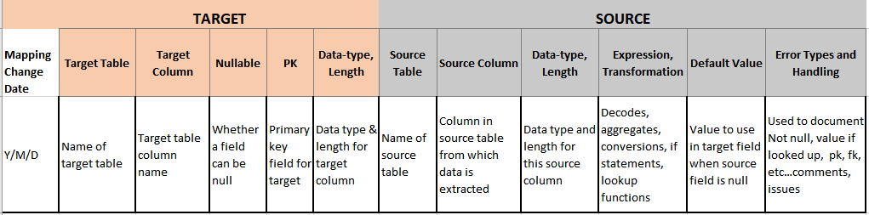
Source to Target Mapping

Slide 6
Why Source-Target Mapping?
Source to Target mapping is an integral part of the data management process. Source to Target Mapping assists in three processes of the ETL pipeline:
Data Integration
Data Migration
Data Transformation

Slide 7
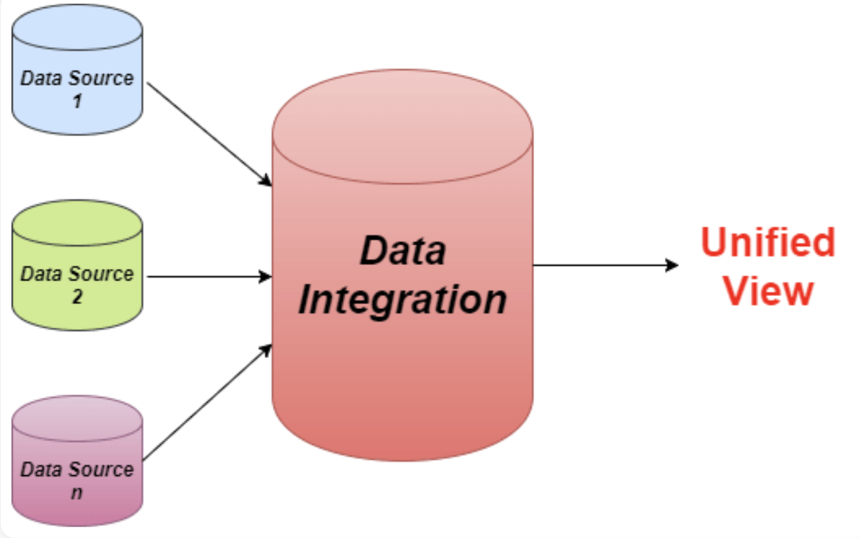
Data Integration
Moving data from one system to another.
In most cases, this movement of data is from the operational database to the data warehouse.

Slide 8
Data Integration
The mapping defines how data sources relate to the data warehouse during data integration. Instructions on how multiple data sources intersect with each, which data record is preferred if duplicate data is found, etc.

Slide 9
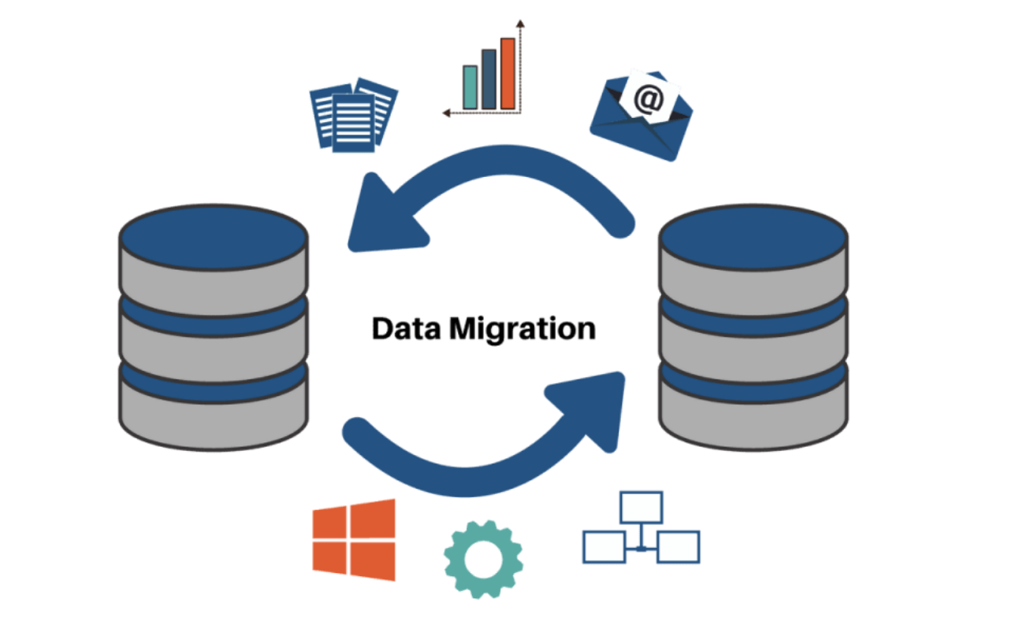
Data Migration
The movement of data from one system to another performed as a one-time process.
In most cases, it is done to ensure that multiple systems have a copy of the same data.

Slide 10
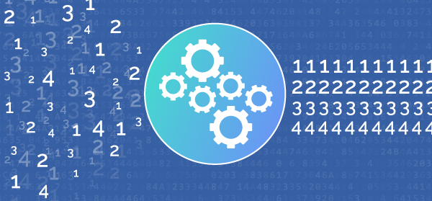
Data Transformation
The conversion of data at the source system to a format required by the destination system.
Includes operations such as data type transformation, handling missing data, etc.
Defines how to map, modify, join, filter, or aggregate data as required by the destination system.

Slide 11
Steps in Source to Target Mapping
Step 1: Defining the Attributes
Defining which tables and which attributes in those tables are to be transferred.
If data integration is being performed, the frequency of integration is also defined in this step.
Step 2: Mapping the Attributes
Once the data to be transferred has been defined, it has to be mapped according to the destination system’s attributes.

Slide 12
Steps in Source to Target Mapping
Step 3: Transforming the Data
Converting the data in a form suitable to be stored in the DW
Step 4: Testing the Mapping Process
Once the first three steps have been completed, it has to be tested on some sample data sources to ensure that the right data attributes in the proper form are mapped correctly with the destination system.

Slide 13
Steps in Source to Target Mapping
Step 5: Deploying the Mapping Process
Upon completion of testing and successful data transfer, migration or integration can be scheduled on the live data as per the user’s requirements.
Step 6: Maintaining the Mapping Process
The Source to Target Mapping process must be maintained and updated periodically to handle large datasets and any new data sources if required.

Slide 14
Source to Target Techniques
Manual - manually code the connection between the source and the destination system. This process can only be used in case the mapping is to be performed for only a few sources that don’t have much data. Advantages
Flexible, Completely customizable to the exact needs of the user
Disadvantages
Manual, Time-consuming, Resource-intensive, Code-dependent, Error-prone.

Slide 15
Source to Target Techniques
Automated – used when the number of sources and the volume of data will increase with each round of data transfer.
Advantages
No technical knowledge required, Fast, Easy to scale, Eliminates human error.
Disadvantages
Training required for use, In-house solutions are expensive to build.

Slide 16
Source to Target Mapping

Slide 17
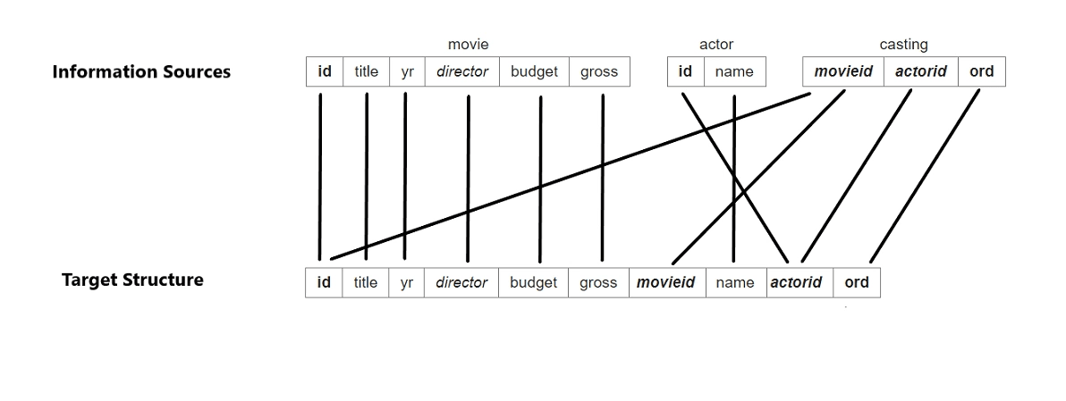
Source to Target Mapping

Slide 18
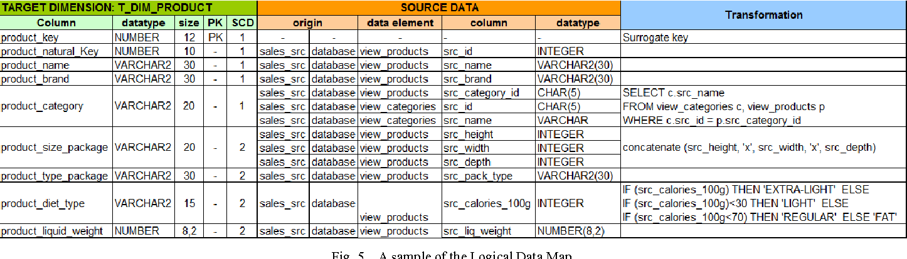
Source to Target Mapping

